Slide 1

Spliceome dynamics during osteogenesis
Part I: PSI measurement using RNA-Seq
Angel Liang
7/4/2020

Slide 2
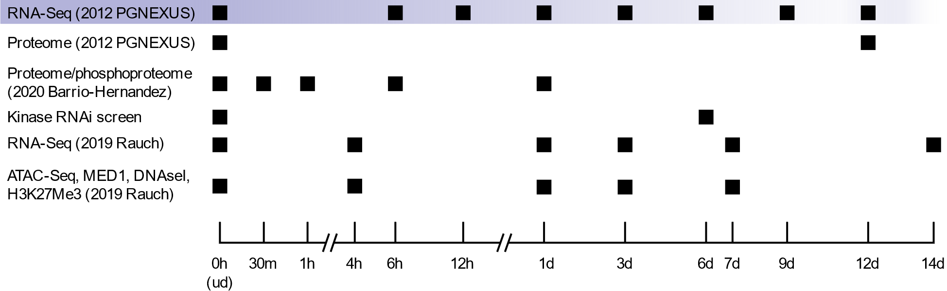
Overview of data
RNA-Seq, hMSC-TERT4 cells induced to differentiate into osteoblasts
PGNEXUS data: 8 timepoints, PAIRED end (2 x 75bp), ~45M reads/sample
2019 Rauch data: 6 timepoints, SINGLE end (1 x 50bp), ~20M reads/sample

Slide 3
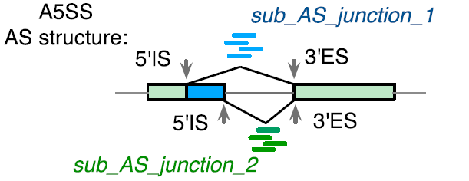
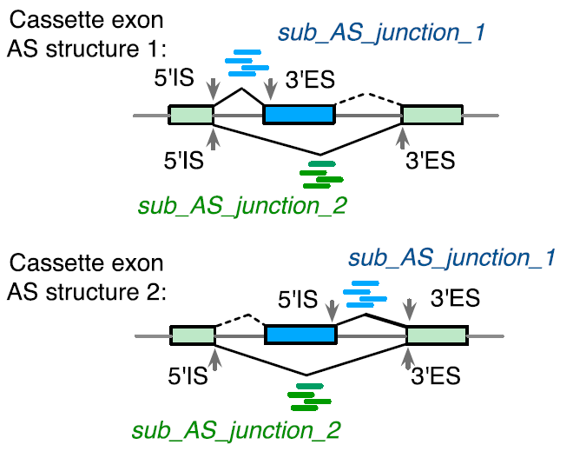
Overview of bioinformatic methods (RNA-Seq)
Reads mapped to reference hg38 genome using STAR (2-pass)
Differential splicing tools:
JUM (Wang et. al., 2018): Junction-centric
Splice graph is constructed
“Junction structures” classified according to differential changes in transcript topology
GLM of junction counts implemented in DEXSeq
PSI values are assigned on a per-junction-structure
PSI-Sigma (Lin et. al., 2019): Exon-centric
For each exon, indexes all possible combinations of upstream + downstream exon based on junction-spanning reads
Each unique combination of connecting exons (always present) and the exon itself is assigned a PSI value
Student t-test on raw counts
Advantage over JUM: can detect changes in first/last exon usage (alternative promoter, alternative poly-A)

Slide 4
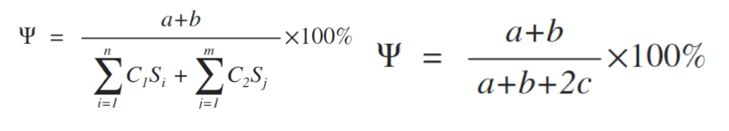
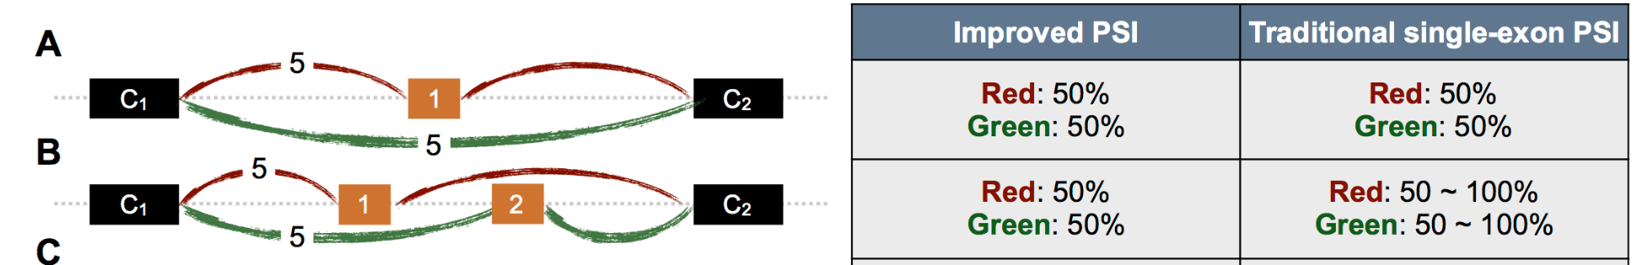
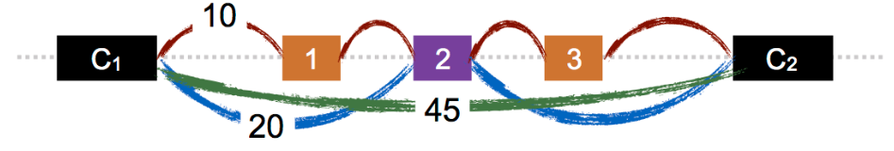
Overview of bioinformatic methods (RNA-Seq)
Reads mapped to reference hg38 genome using STAR (2-pass)
Differential splicing tools:
JUM (Wang et. al., 2018): Junction-centric
Splice graph is constructed
“Junction structures” classified according to differential changes in transcript topology
GLM of junction counts implemented in DEXSeq
PSI values are assigned on a per-junction-structure
PSI-Sigma (Lin et. al., 2019): Exon-centric
For each exon, indexes all possible combinations of upstream + downstream exon based on junction-spanning reads
Each unique combination of connecting exons (always present) and the exon itself is assigned a PSI value (more correctly, it’s PSI value per LSV*)
Student t-test on raw counts
Advantage over JUM: can detect changes in first/last exon usage (alternative promoter, alternative poly-A)
New PSI index of PSI-Sigma
*LSV = Local Splice Variant

Slide 5
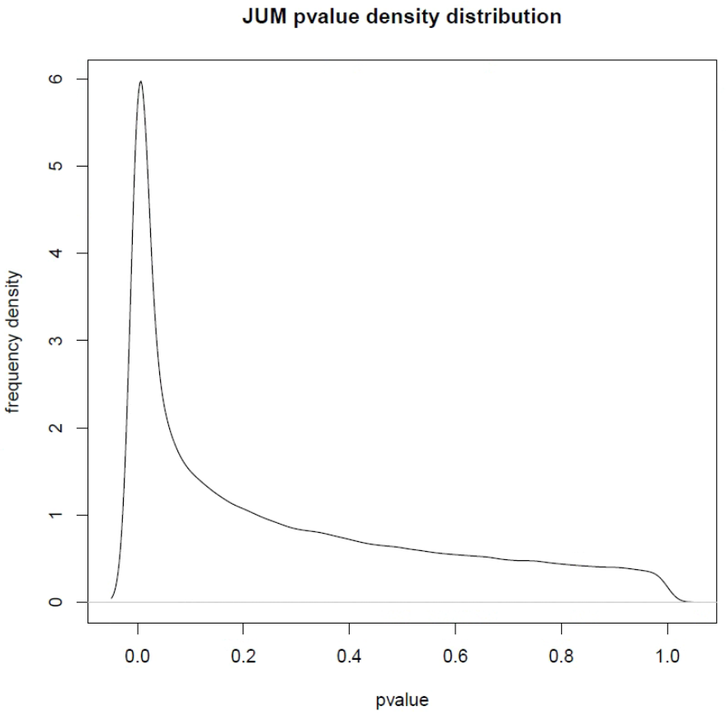
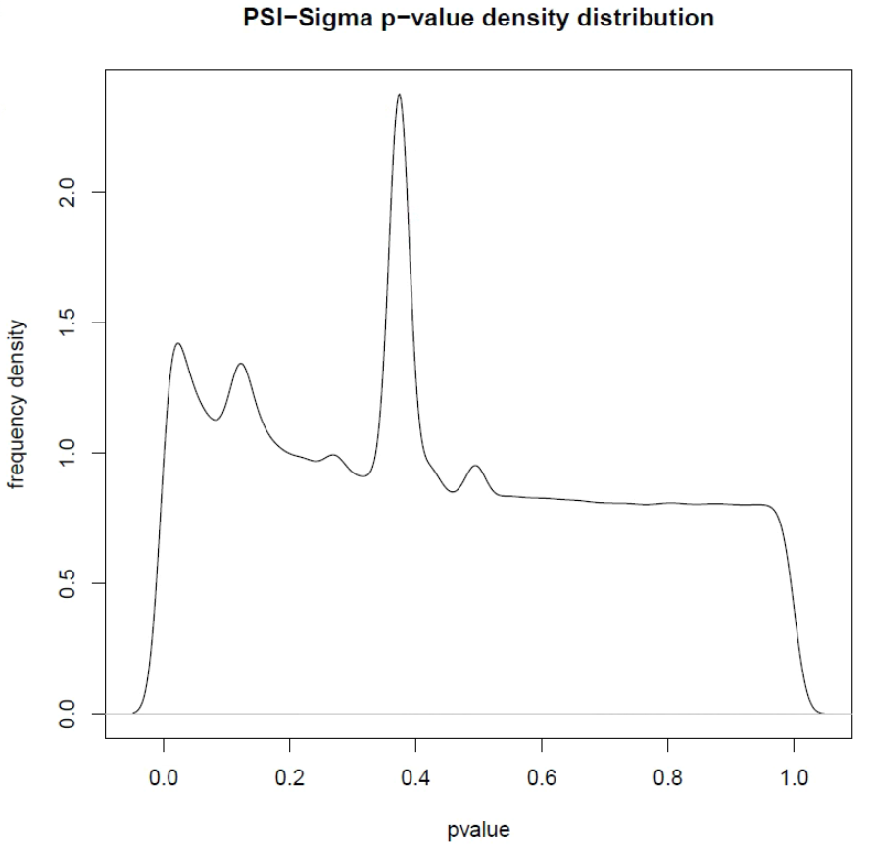
Frequency density distributions of p-value

Slide 6
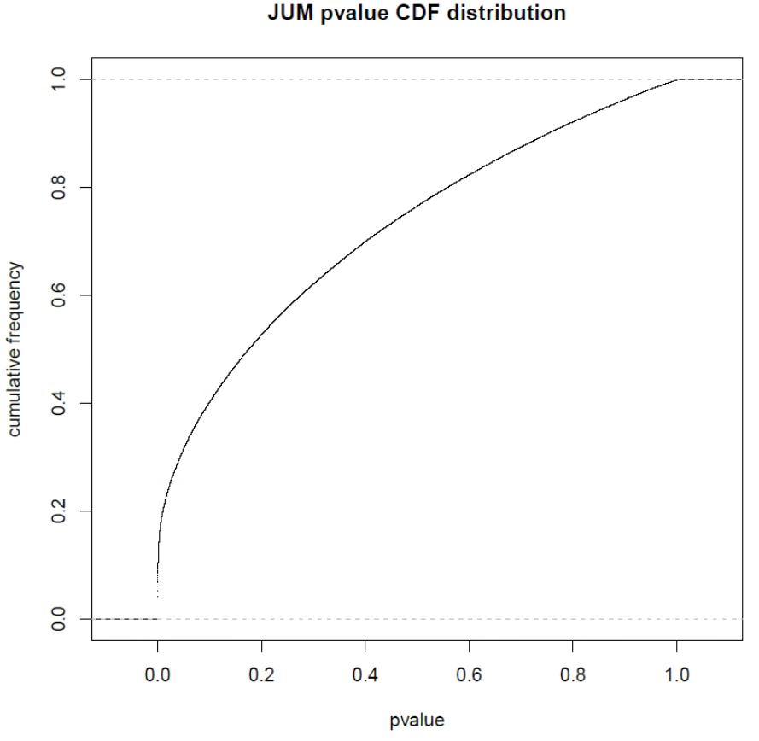
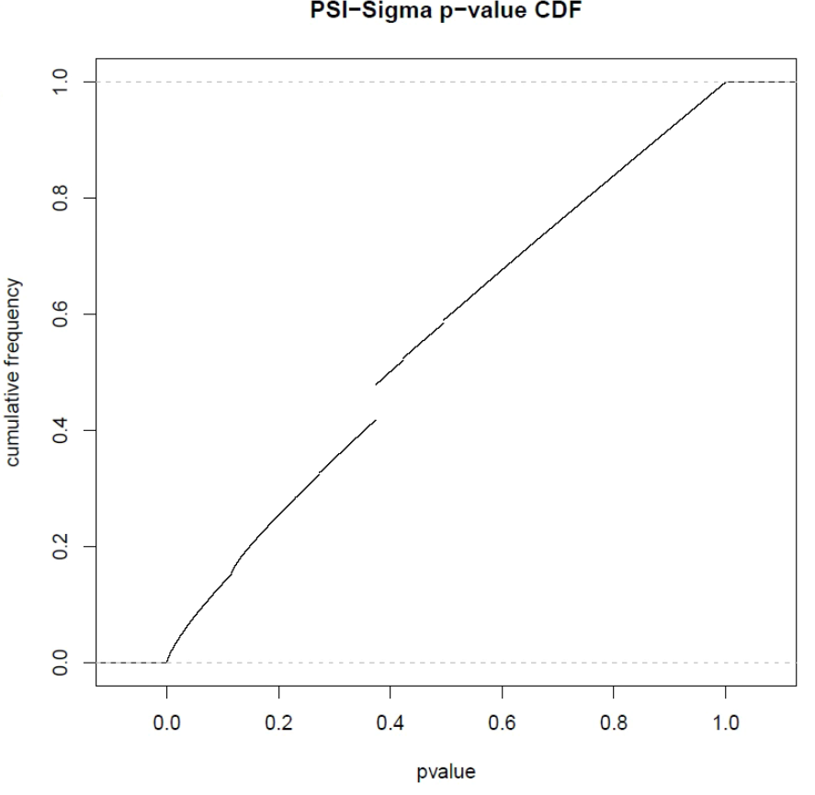
CDF of p-value

Slide 7
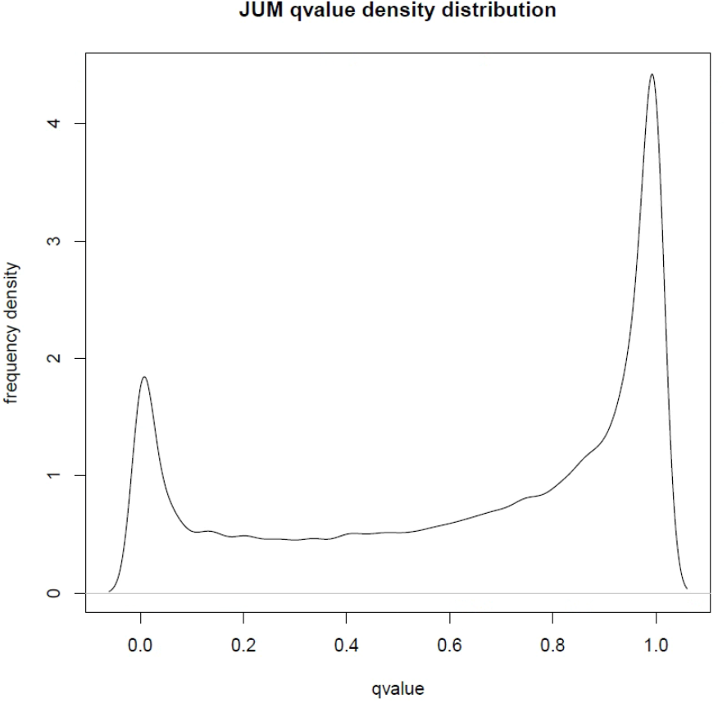
Frequency density distributions of q-value
Benjamini-Hochberg

Slide 8
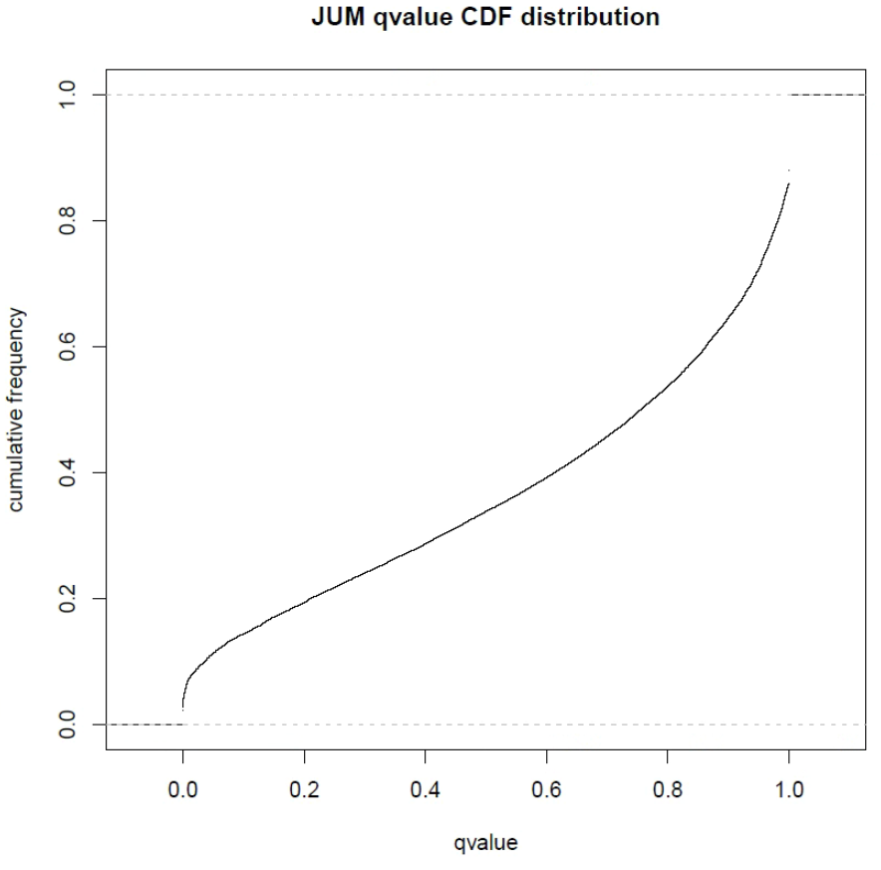
CDF of q-value

Slide 9
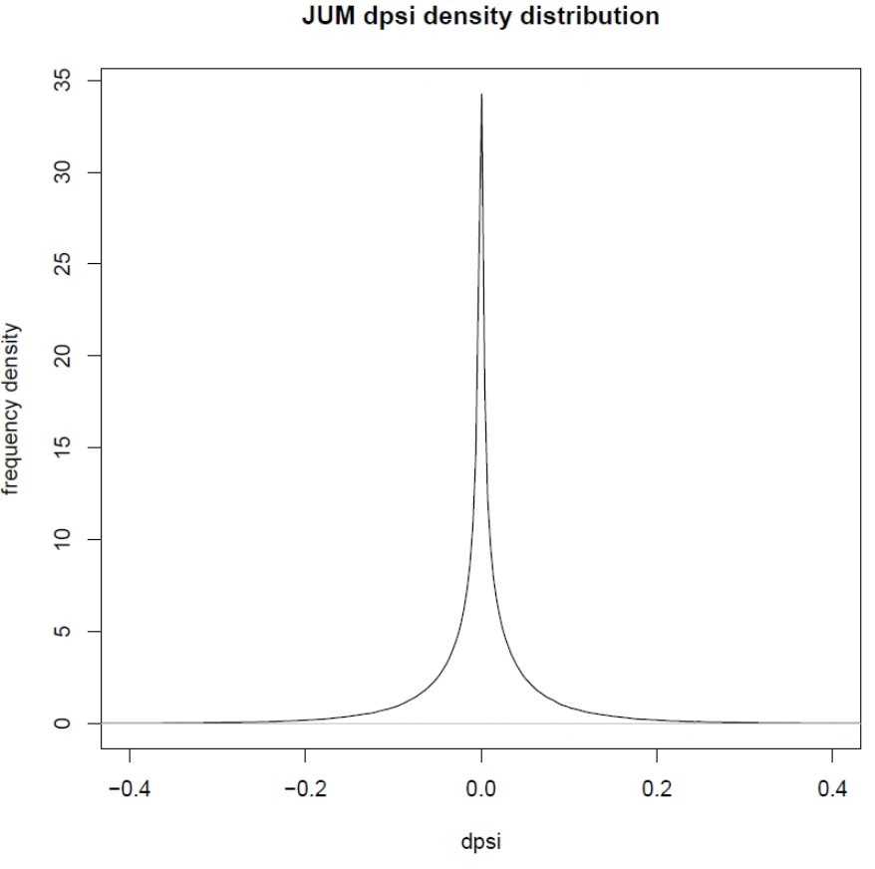
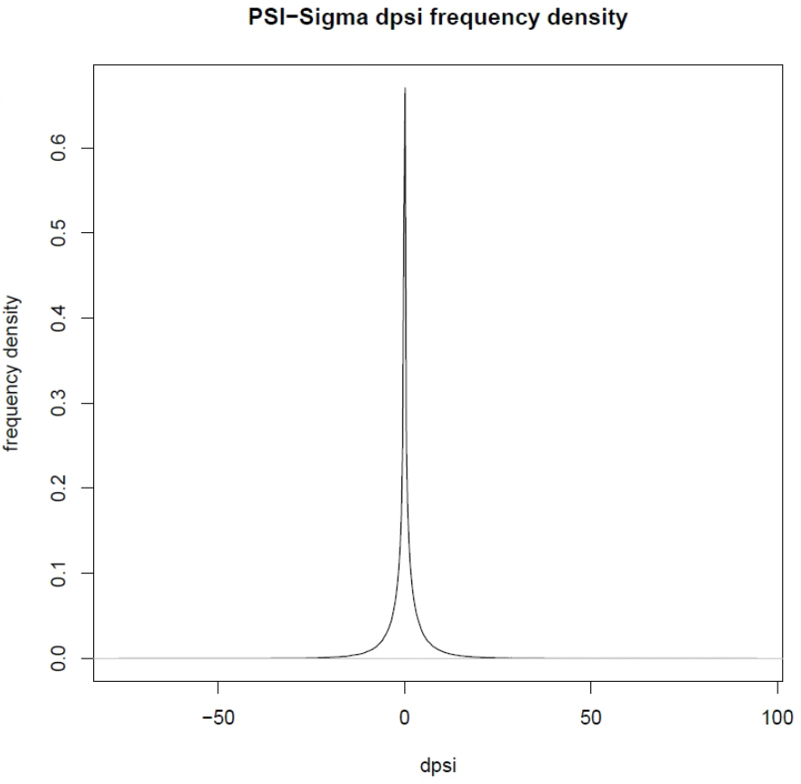
Frequency density distributions of ΔPSI

Slide 10
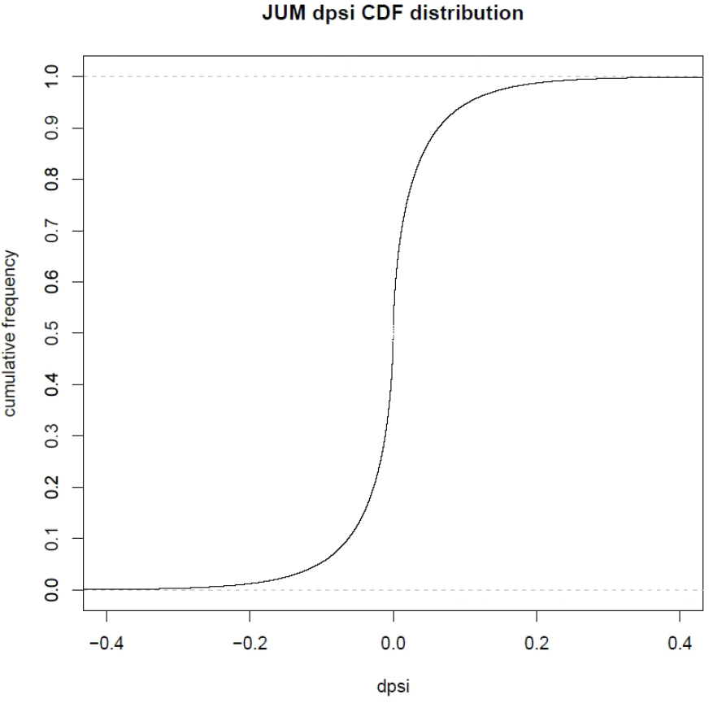
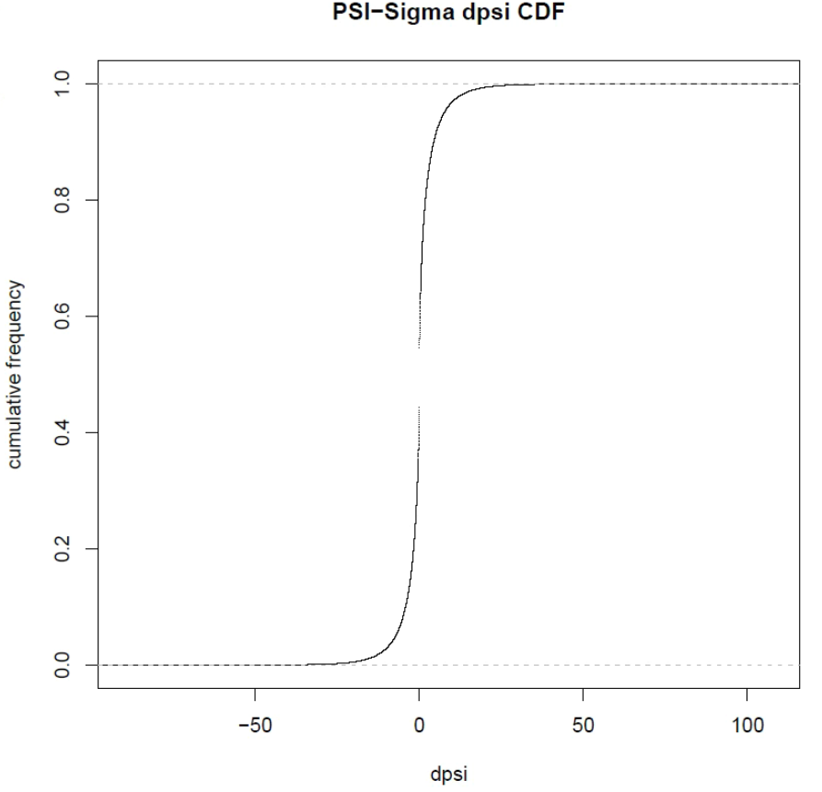
CDF of ΔPSI

Slide 11
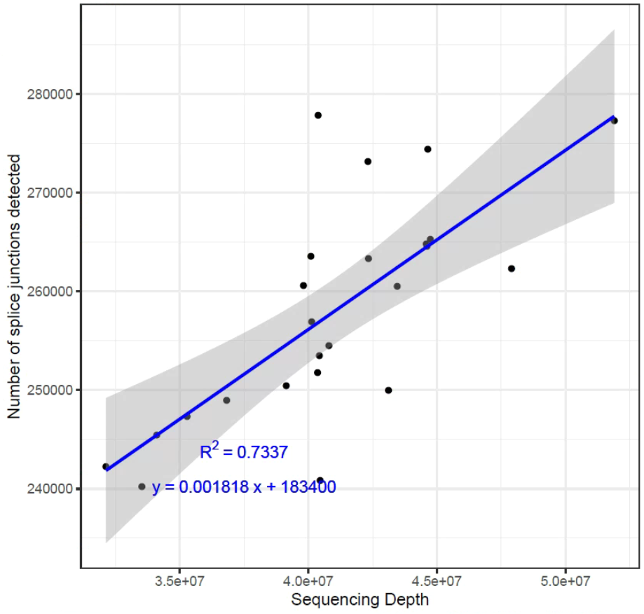
Quality check: dependence of the no. of junctions/exons detected upon the sequencing depth
JUM
PSI-Sigma mixes up values for each replicate. Order is different per LSV.

Slide 12
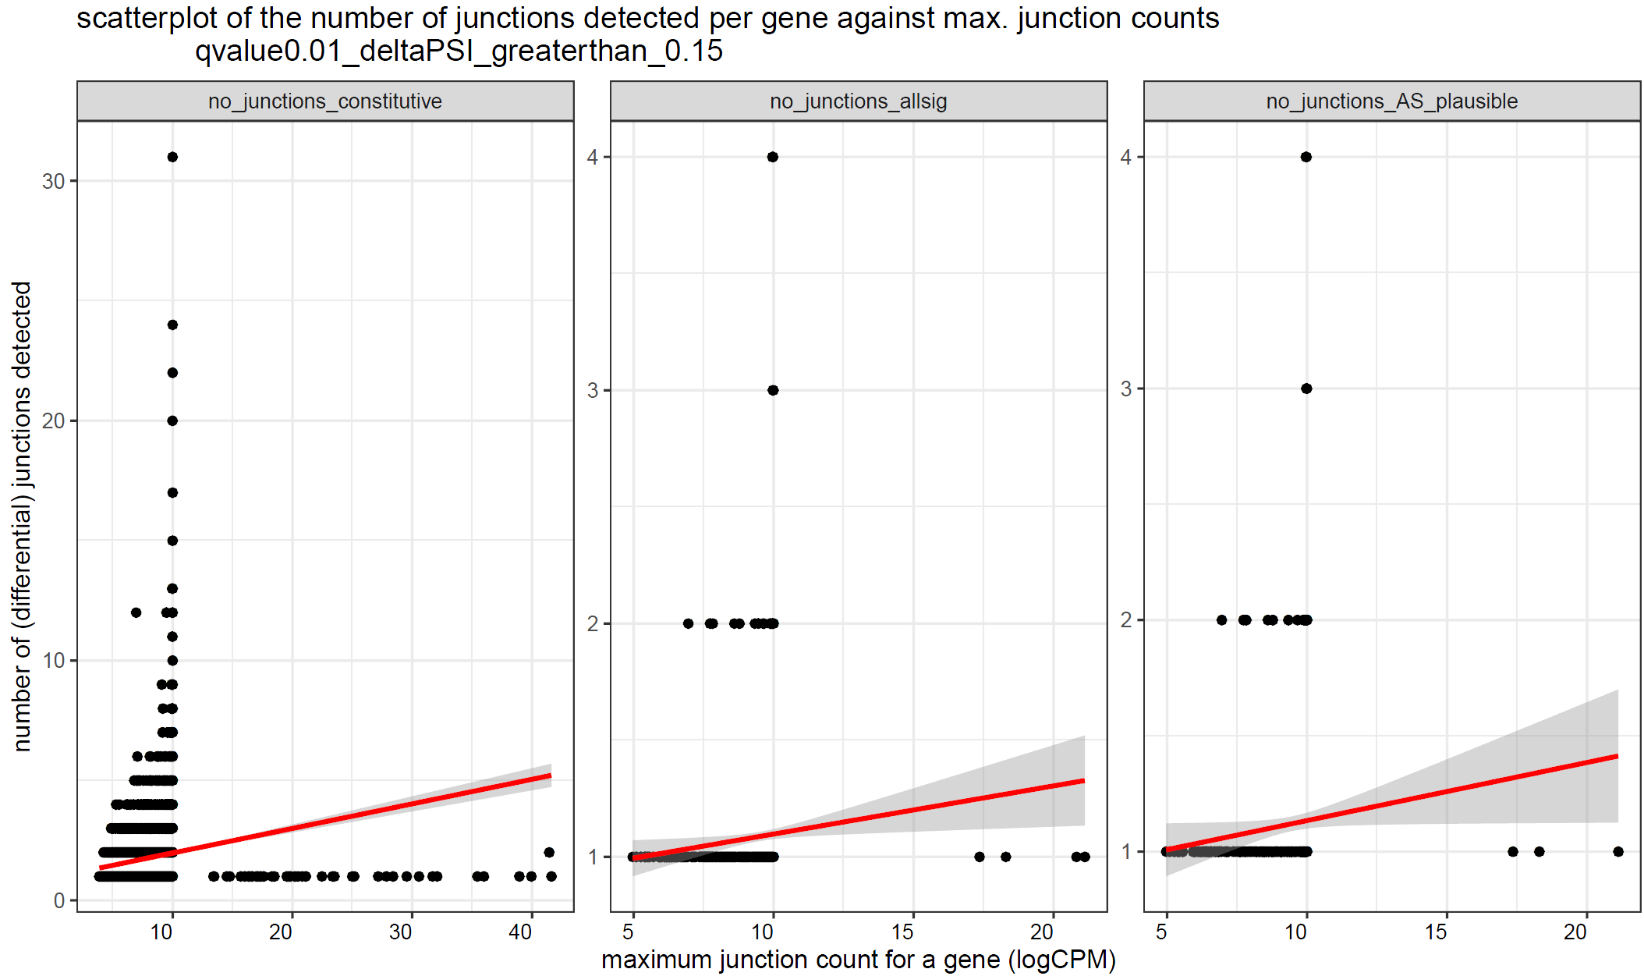
Quality check: are there more junctions or exons/gene with increasing junction count? (JUM)

Slide 13
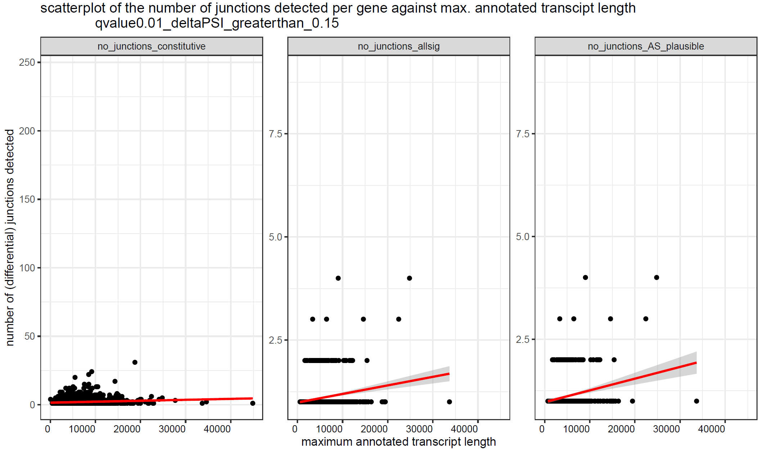
Quality check: are there more junctions or exons/gene with increasing transcript length? (JUM)

Slide 14
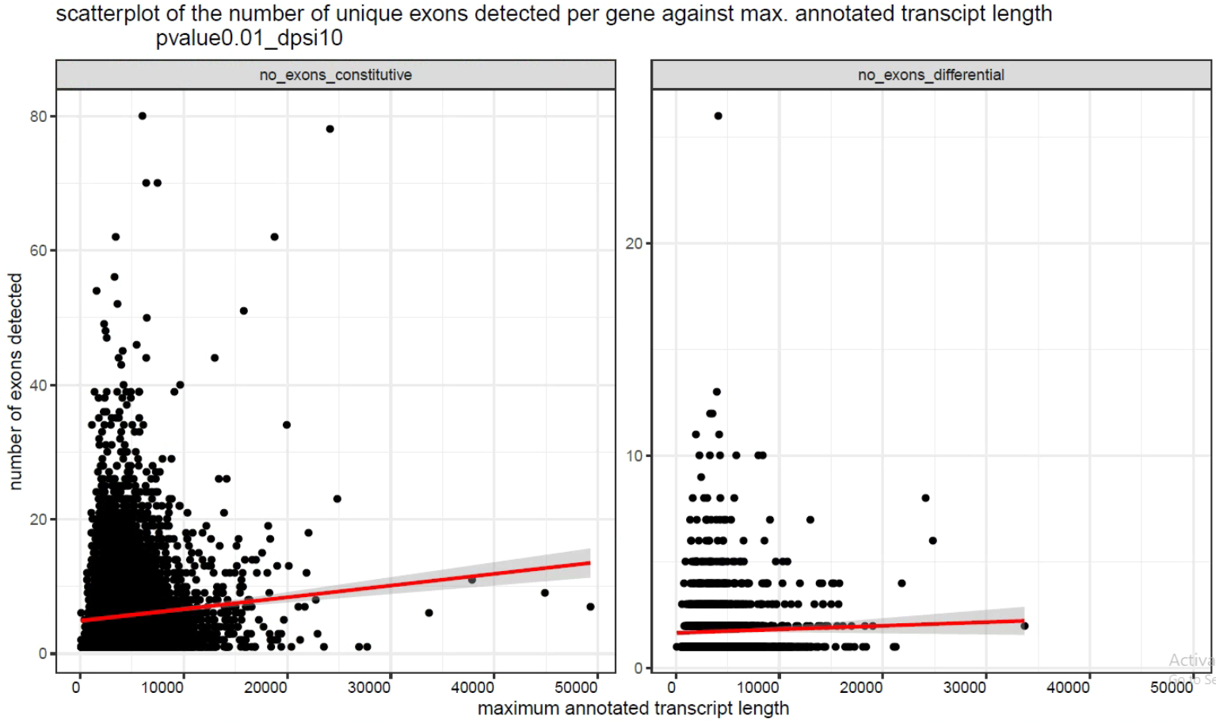
Quality check: are there more junctions or exons/gene with increasing transcript length? (PSI-Sigma)

Slide 15
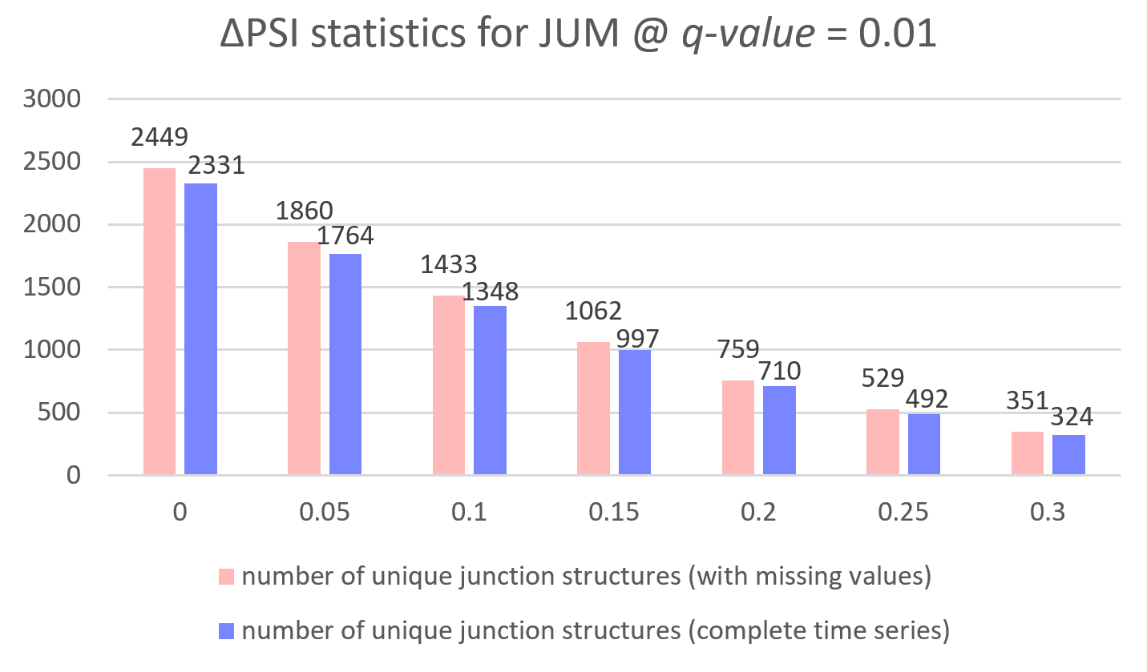
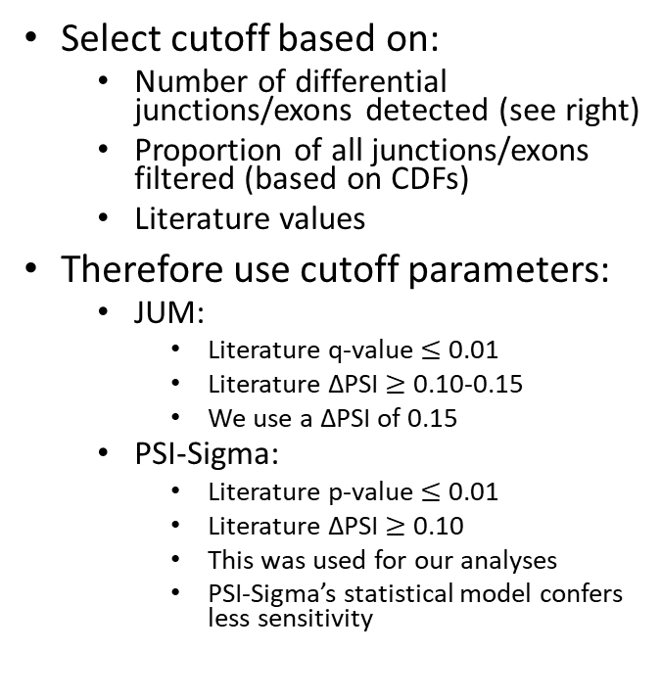
P/Q-value and ΔPSI cutoff determination
Select cutoff based on:
Number of differential junctions/exons detected (see right)
Proportion of all junctions/exons filtered (based on CDFs)
Literature values
Therefore use cutoff parameters:
JUM:
Literature q-value $≤$ 0.01
Literature ΔPSI $≥$ 0.10-0.15
We use a ΔPSI of 0.15
PSI-Sigma:
Literature p-value $≤$ 0.01
Literature ΔPSI $≥$ 0.10
This was used for our analyses
PSI-Sigma’s statistical model confers less sensitivity

Slide 16
JUM junction structures: sometimes seem too long

Slide 17
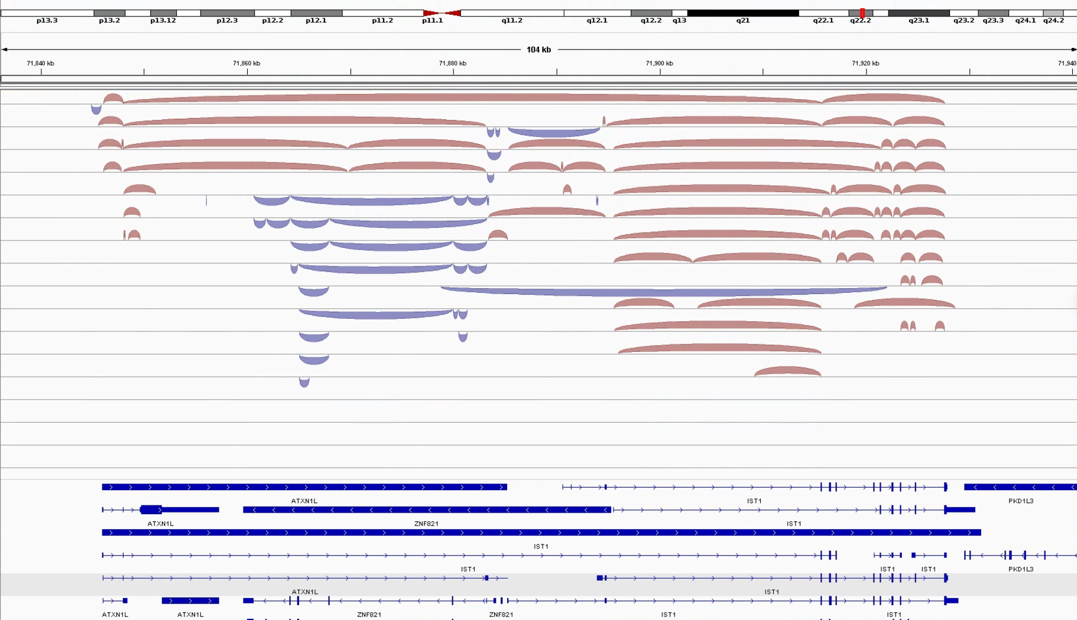
“Implausible” JUM junction: A3SS called in ATXN1L
lncRNA

Slide 18
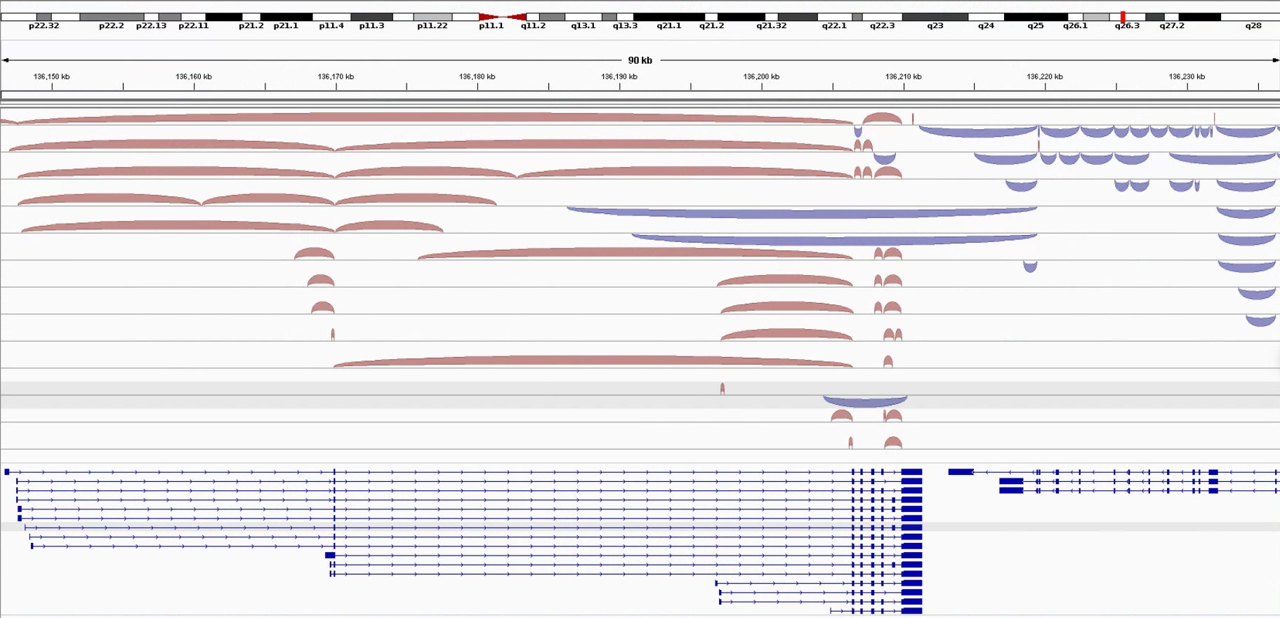
“Implausible” JUM junction: Claimed A5SS in FHL1

Slide 19
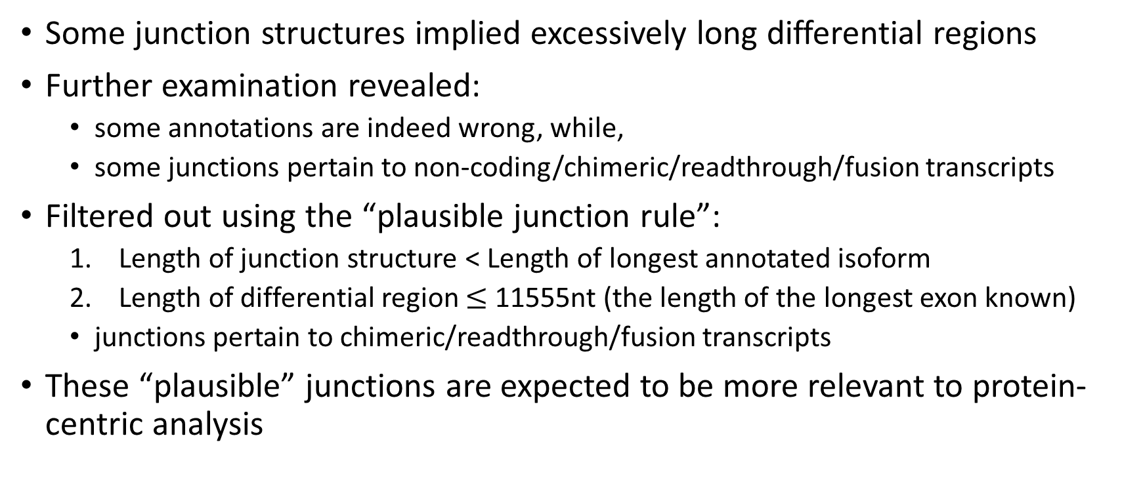
JUM junction structures: sometimes seems to be “wrong”
Some junction structures implied excessively long differential regions
Further examination revealed:
some annotations are indeed wrong, while,
some junctions pertain to non-coding/chimeric/readthrough/fusion transcripts
Filtered out using the “plausible junction rule”:
Length of junction structure < Length of longest annotated isoform
Length of differential region $≤$ 11555nt (the length of the longest exon known)
junctions pertain to chimeric/readthrough/fusion transcripts
These “plausible” junctions are expected to be more relevant to protein-centric analysis

Slide 20
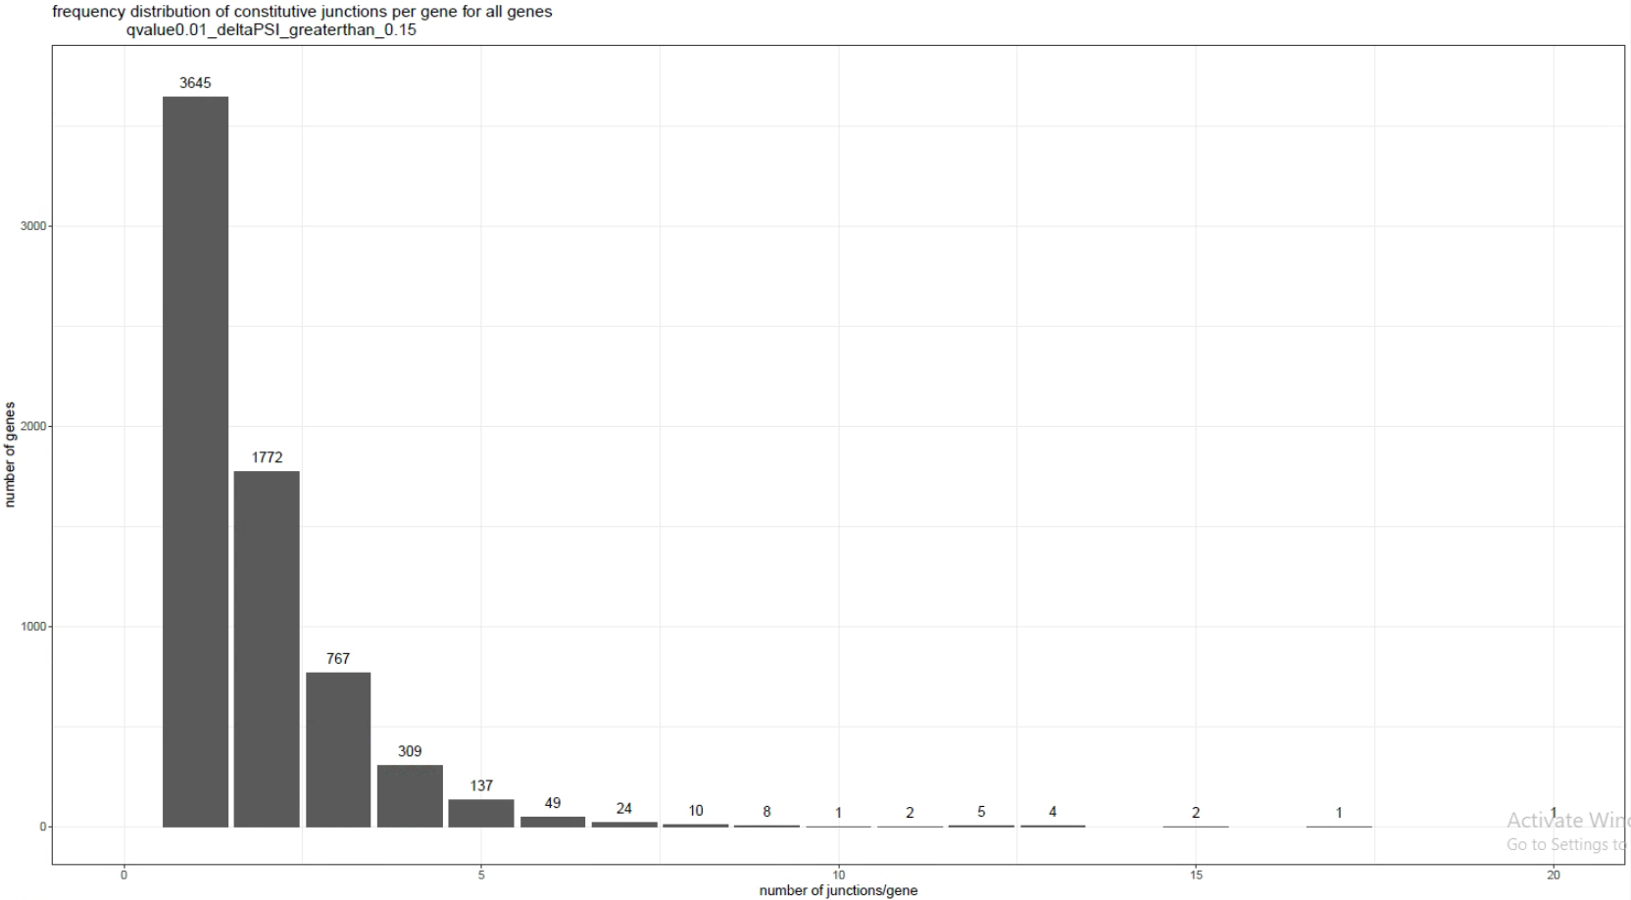
JUM junction structures detected/gene - constitutive
Global average: 1.828 unique junction structures/gene.
Ratio #1/#2: 2.057

Slide 21
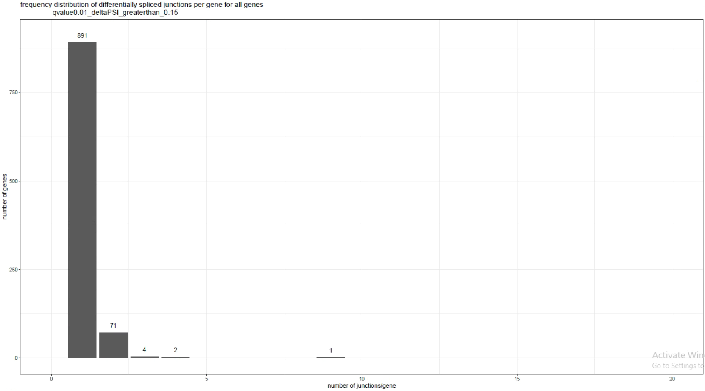
JUM junction structures detected/gene – differential (all)
Global average: 1.08 unique junction structures /gene.
Ratio #1/#2: 12.549

Slide 22
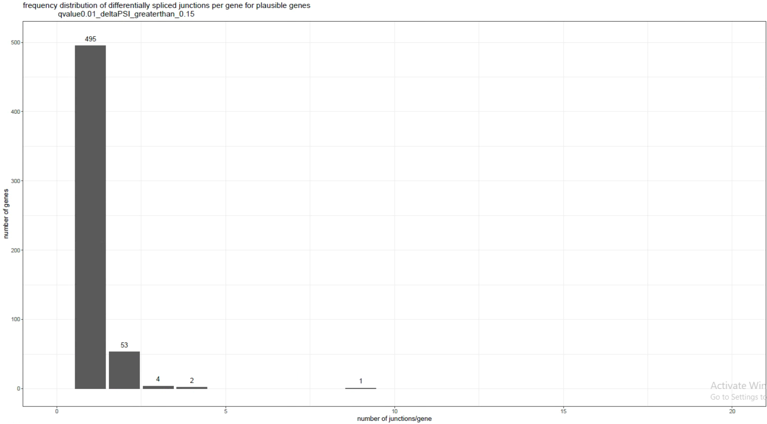
JUM junction structures detected/gene – differential (plausible)
Global average: 1.125 unique junction structures /gene.
Ratio #1/#2: 9.3396

Slide 23
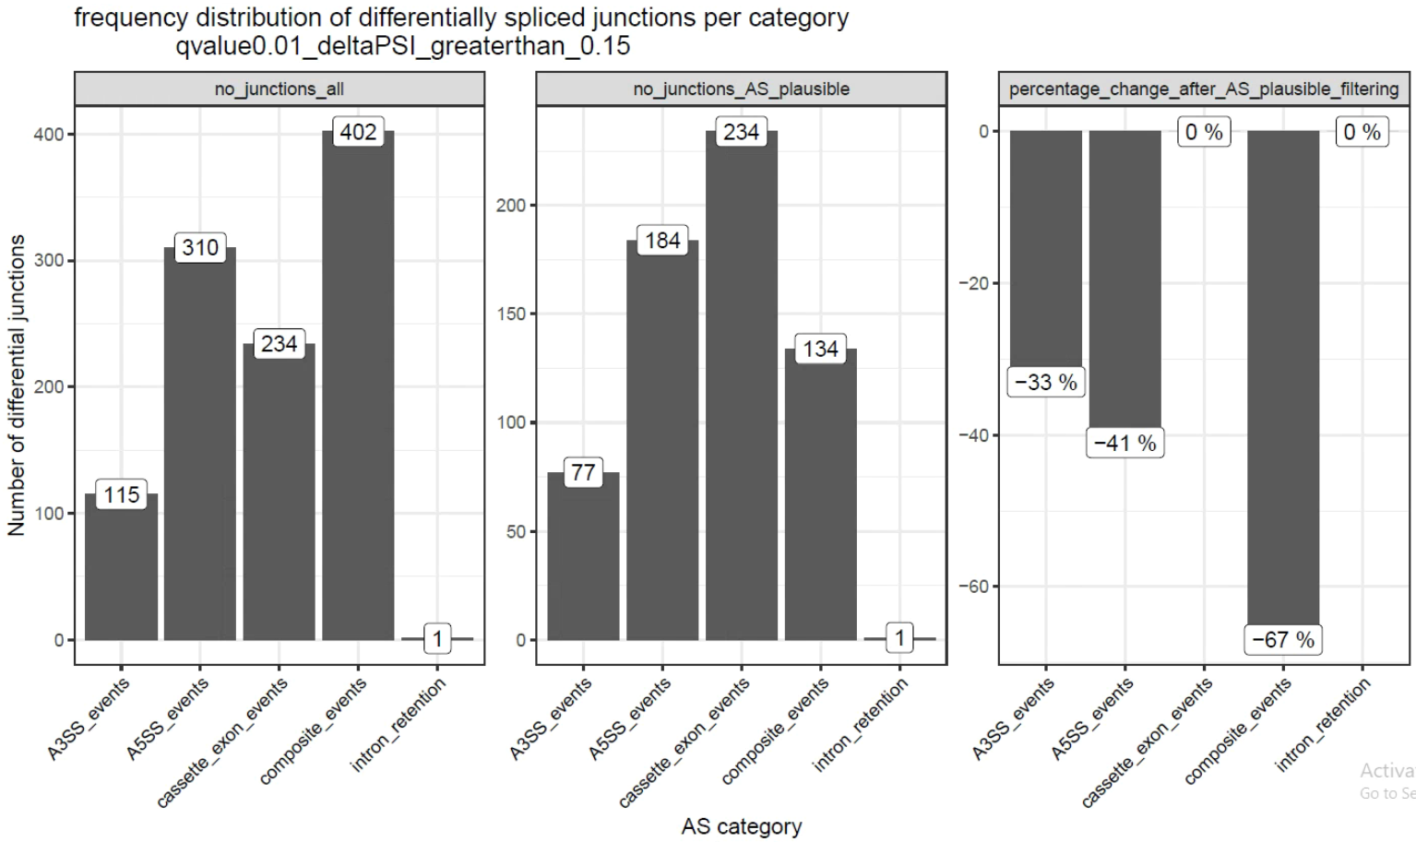
Change in the amount of junction structures after plausible filtering

Slide 24
Plausible filtering appears to have the desired effect
These results are expected:
Literature reports that cassette exon events are the most common
Cassette exon and MXE events (not shown) have a stricter definition, hence more robust
Some implausible junction structures result from failure of JUM to detect alternative first/last exons – complementary approach is warranted

Slide 25
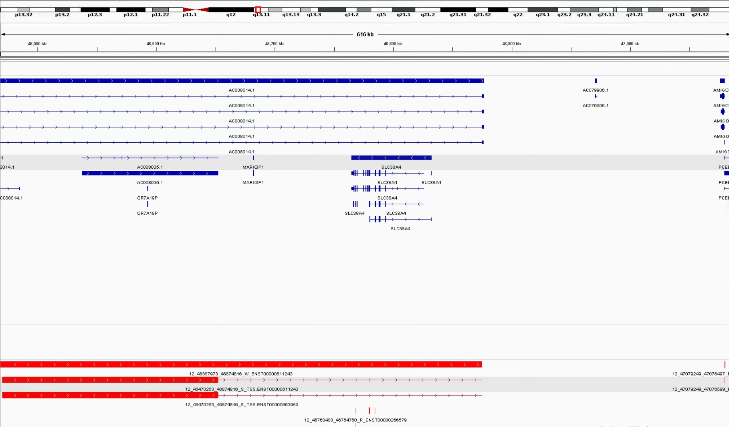
Implausible exons in PSI-Sigma
Called exon has a width of 224395!

Slide 26
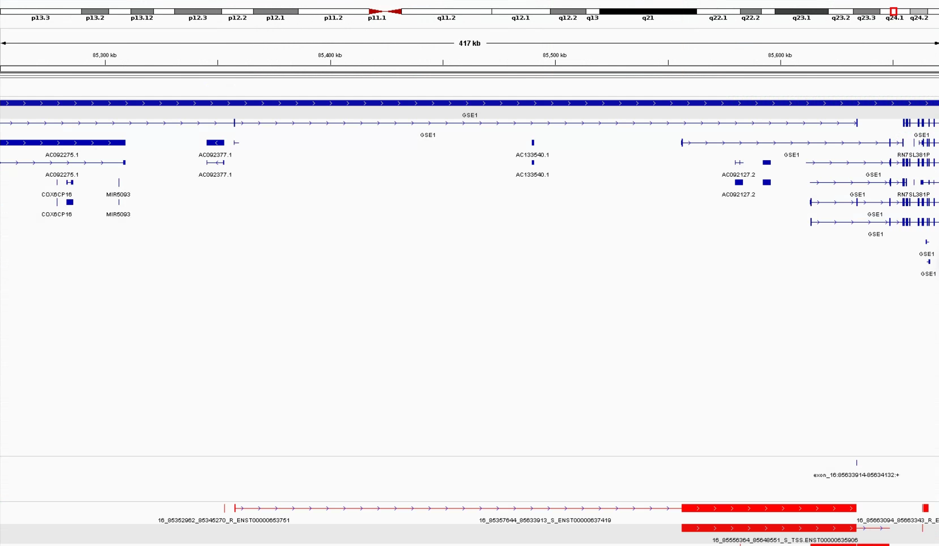
Implausible exons in PSI-Sigma

Slide 27
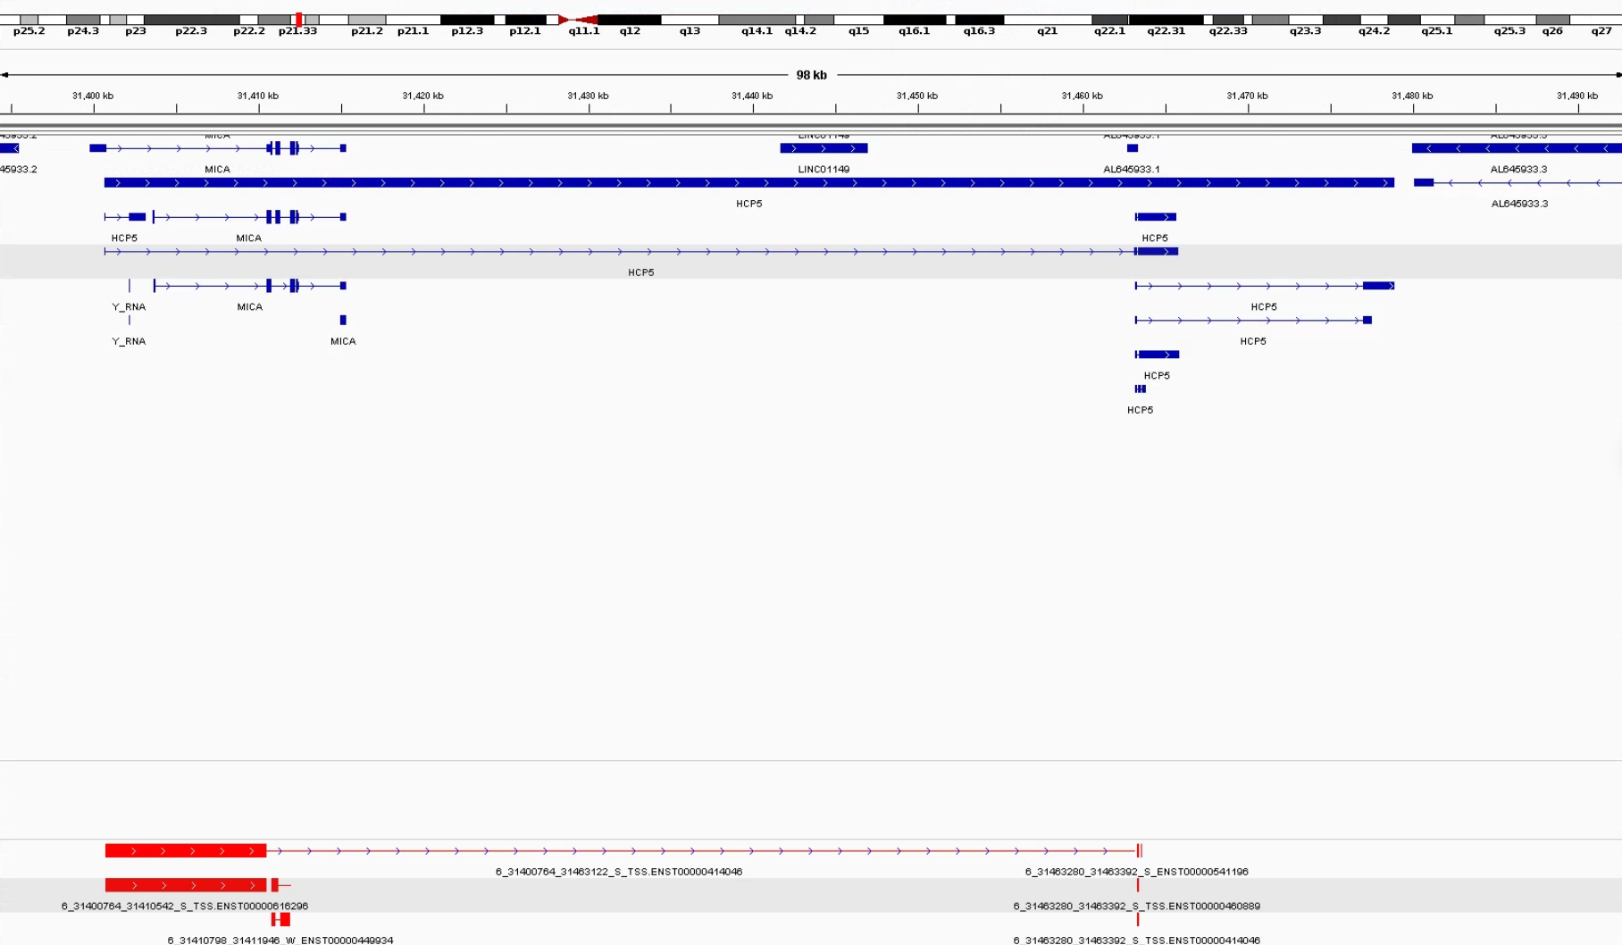
Implausible exons in PSI-Sigma

Slide 28
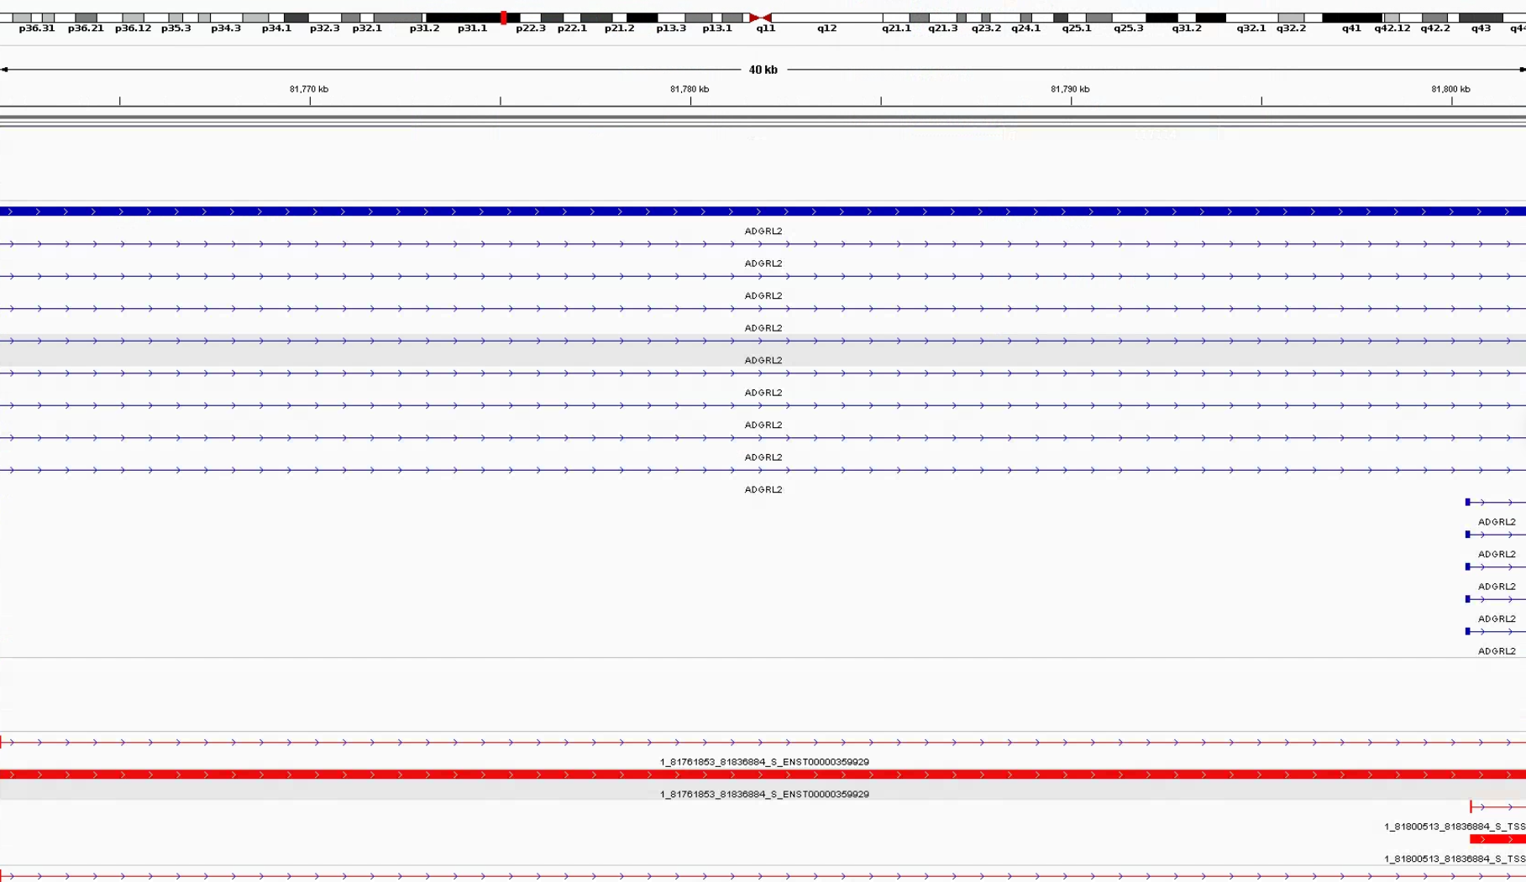
Implausible exons in PSI-Sigma

Slide 29
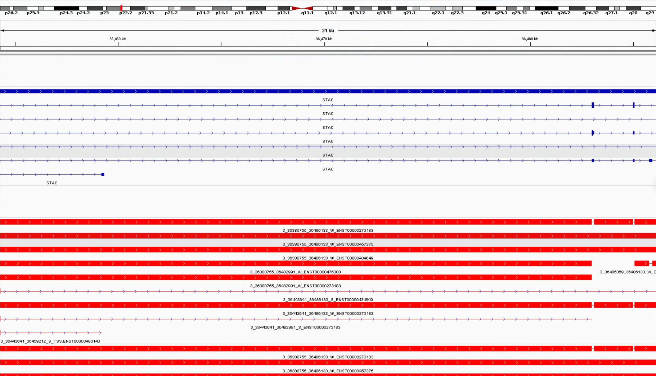
Implausible exons in PSI-Sigma

Slide 30
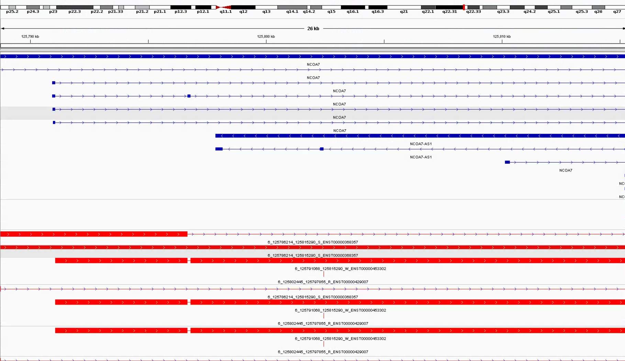
Implausible exons in PSI-Sigma

Slide 31
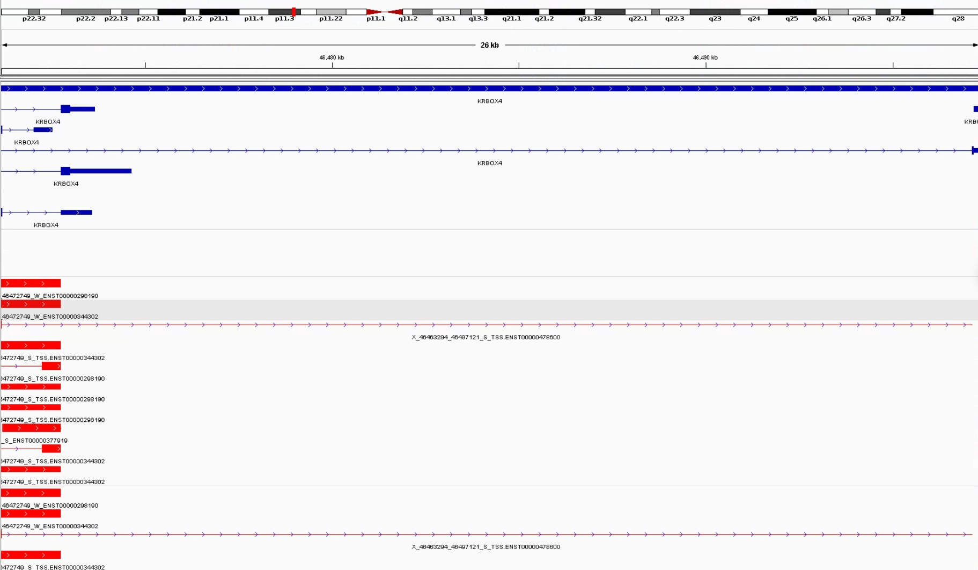
Implausible exons in PSI-Sigma

Slide 32
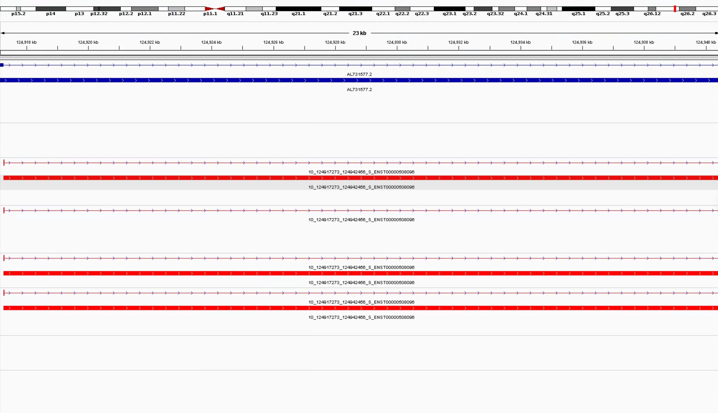
Implausible exons in PSI-Sigma

Slide 33
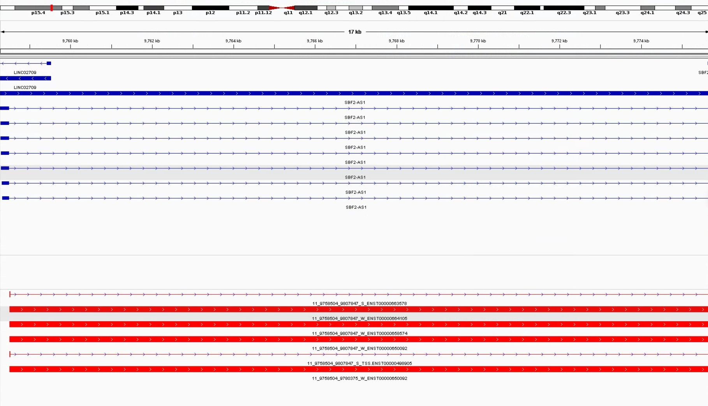
Implausible exons in PSI-Sigma

Slide 34
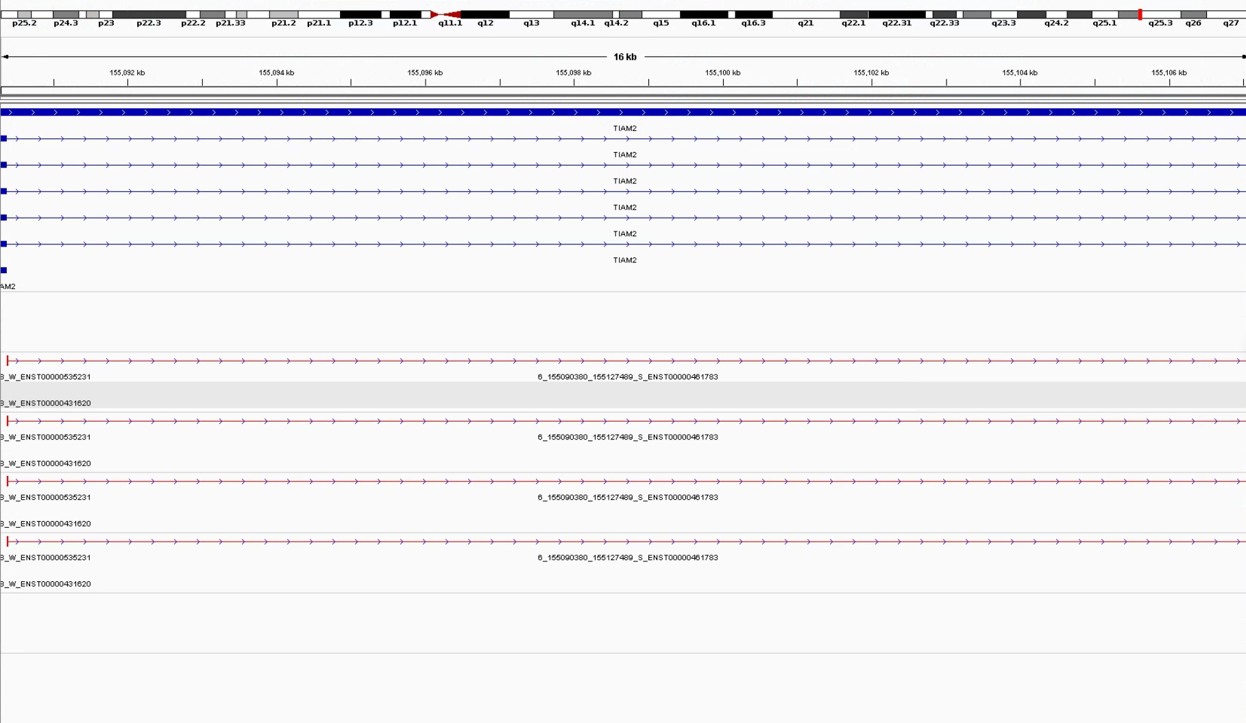
Implausible exons in PSI-Sigma

Slide 35
Seemingly implausible junctions in PSI-Sigma are real
Could not manually find examples of technical artifacts resulting in very long (> 11555 nt) exons
PSI-Sigma is very good at finding retained introns (though it’s unclear how)
“Implausible” exons are still filtered out for reference-overlapping exon ontology analyses.

Slide 36
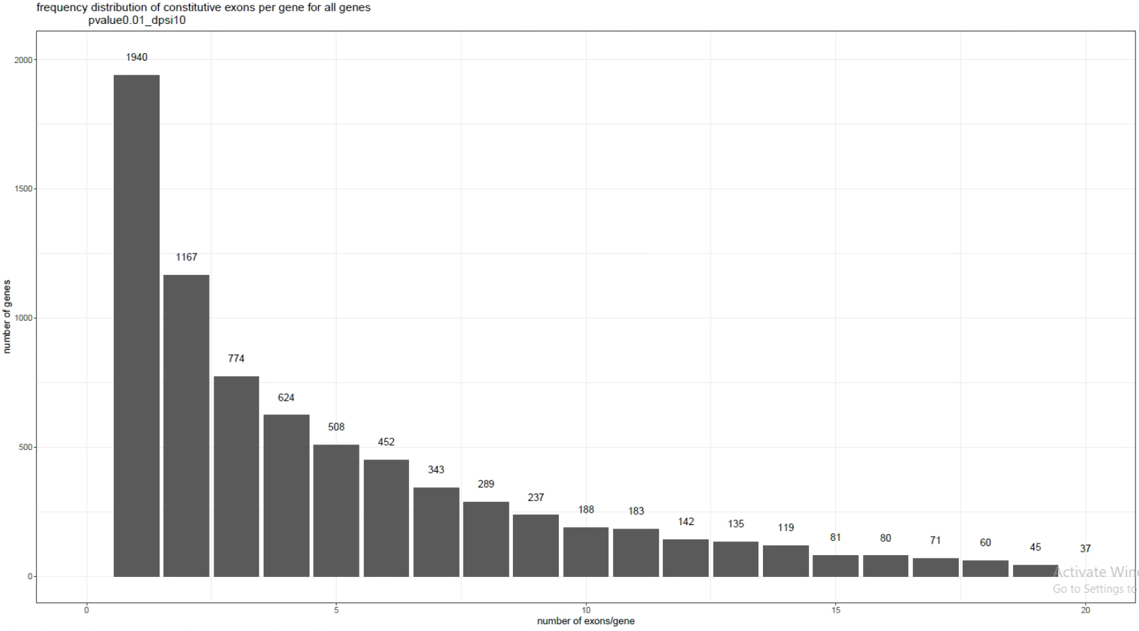
PSI-Sigma exon structures detected/gene – all
Global average: 5.679995 unique junction structures /gene.
Ratio #1/#2: 1.662

Slide 37
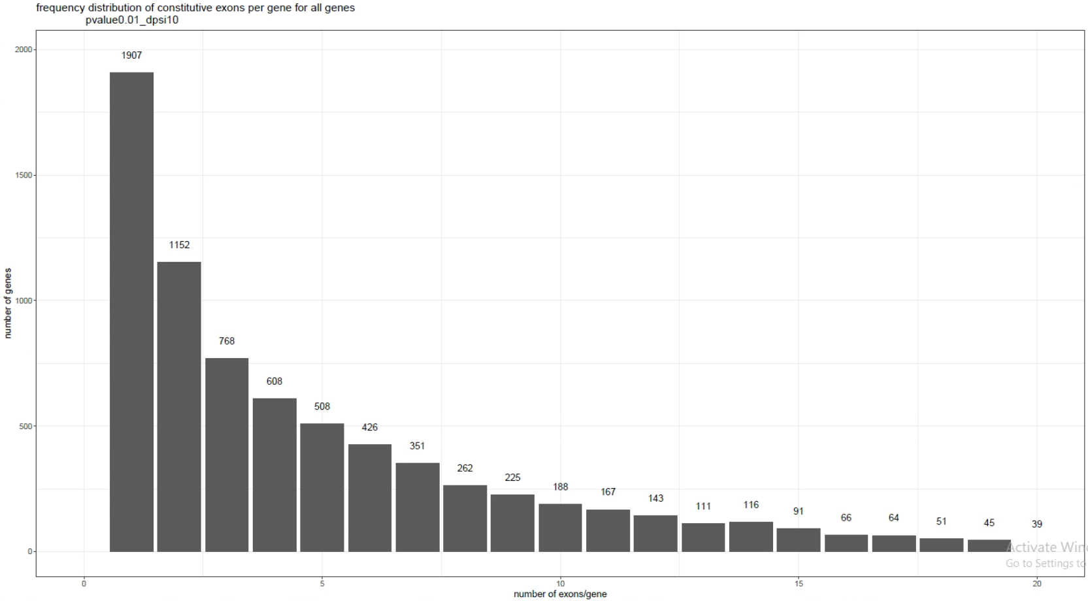
PSI-Sigma exon structures detected/gene – constitutive
Global average: 5.525 unique junction structures /gene.
Ratio #1/#2: 1.655

Slide 38
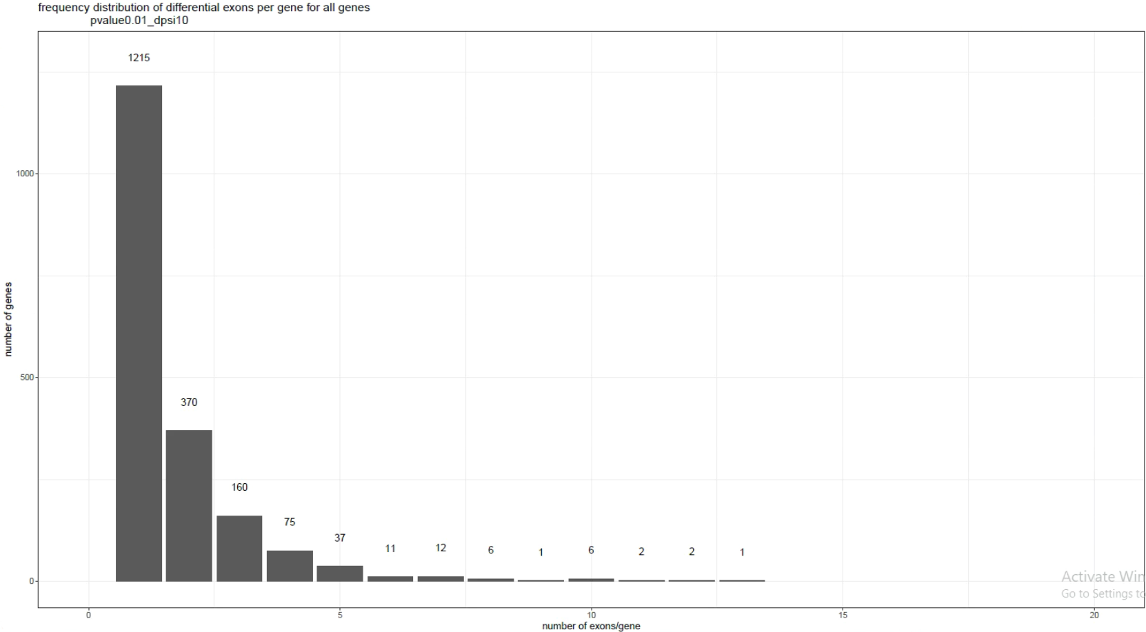
PSI-Sigma exon structures detected/gene – differential
Global average: 1.723 unique junction structures /gene.
Ratio #1/#2: 3.284

Slide 39
Junctions/exons detected in common
343
(32.3%)
(10.5%)
JUM
ΔPSI > 15%
q-value < 0.01
719
2929
PSI-Sigma
ΔPSI > 10%
p-value < 0.01
546
(51.4%)
(6.7%)
PSI-Sigma
(everything)
JUM
(everything)
1416
(11.2%)
(43.3%)
JUM
ΔPSI > 15%
q-value < 0.01
1856
PSI-Sigma
ΔPSI > 10%
p-value < 0.01
516
43349
11277

Slide 40
Junctions/exons detected in common
JUM
(everything)
6344
(50.0%)
(14.5%)
PSI-Sigma
(everything)
6349
37551

Slide 41
Junctions/exons detected in common (in common genes)
322
(82.6%)
(44.4%)
JUM
ΔPSI > 15%
q-value < 0.01
68
403
PSI-Sigma
ΔPSI > 10%
p-value < 0.01
514
(74.2%)
(9.3%)
PSI-Sigma
(everything)
JUM
(everything)
1275
(46.8%)
(52.8%)
JUM
ΔPSI > 15%
q-value < 0.01
1140
PSI-Sigma
ΔPSI > 10%
p-value < 0.01
179
5027
1450

Slide 42
Junctions/exons detected in common (in common genes)
6099
(74.9%)
(19.6%)
JUM
(everything)
PSI-Sigma
(everything)
2039
25041

Slide 43
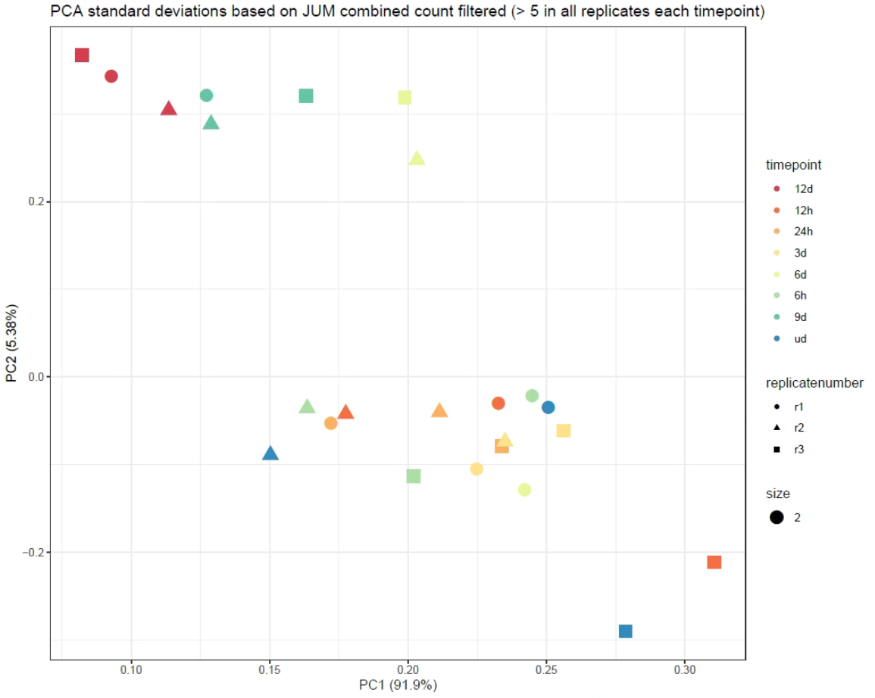
PCA analysis of JUM
High levels of batch effect/technical artifacts/bias in raw counts
Performing intermediate normalization is not straightforward – requires hacking of the JUM script
It’s unknown whether the GLM implemented in DEXSeq is able to remove technical bias
A suitable normalization method must be able to preserve the dynamic range (0-100%) of PSI values
Normalisation was not explored any further

